Slide 1
Procurement and put-into-operation of the Multifunctional Measurement Vehicle (MFMT)
Preliminary market consultation 12th of november 2020.

Slide 2
Planned agenda
Welcome of the participants
Brief review of the object of the procurement
Questions and answers
The further planned milestones of the procedure

Slide 3
The aim of the preliminary market consultation
Market survey by means of which we would like to prepare an open official public procurement procedure.
Based on that we plan to specify the budget of the project.
We would like to inform ourselves on the most advanced technical solutions.

Slide 4
The main technical parameters of the vehicle
The vehicle shall have a maximum speed of 160 km/h driven by its own traction chain
The minimum horizontal track curvature is 100 m
The maximum axle load shall not exceed 18 tons.
The rooms built into the vehicle: measurement room, minimum 4 pieces sleeping room, dining room (with preparation of warm foods)- conference room, bathroom, closed-type toilet, gangway, workshop, aggregator room.
Traction chain: hydrodynamic gearbox (with built-in direction reverser), gear brake
Questions have been emerged during the consultation
Is a dual-drive allowed (diesel and electric)? Yes, it is allowed. In this case obviously a diesel-powered vehicle shall have electrical power transmission
If the dual-drive is allowed what are the maximum speeds of the individual drives? Minimum 160 km/h is necessary.

Slide 5
The planned measurement systems
Video Track Inspections System
GSM-R measurement system
ETCS test and measurement system
Global Positioning System
Catenary measurement system

Slide 6
The services of the Video Track Inspection System
Recognition and recording of the mechanical parts of the railway track
Panorama picture
Recognition and determination of the faults of the structural parts
Office system for data processing, assessing, analysing and archiving

Slide 7
The main technical requirements of the Video Track Inspections System
Measurement speed range: 0 - 160 km/h
Measurement directions: both directions, forward and backward
Acceleration range: ± 0.5 m/s2
Measurement capability: 500 km/day
Weather conditions: every excluded the heavy rain/snow fall
Operational air temperature: - 10 - + 50 °C
Storage air temperature: - 20 - + 55 °C
Humidity: up to 95 %
Lighting conditions: bright sunshine
night and tunnel circumstances
dark and artificial lighting

Slide 8
The elements of the superstructure inspected by the Video Track Inspection System
Rail
Fastenings
Sleeper
Ballast
Turnout
Other structures, track accesories
Level-crossing

Slide 9
Fault lists
Numerical fault list (actual measurement)
Fault list with pictures (actual measurement)
Numerical „Change” fault list (change referring to the base measurement)
„Change” fault list with pictures (change compared to the base measurement)

Slide 10
Catenary measurement system
Static measurement
Dynamic measurement
Heat camera system
Infra camera system
Video inspection system for catenary line

Slide 11
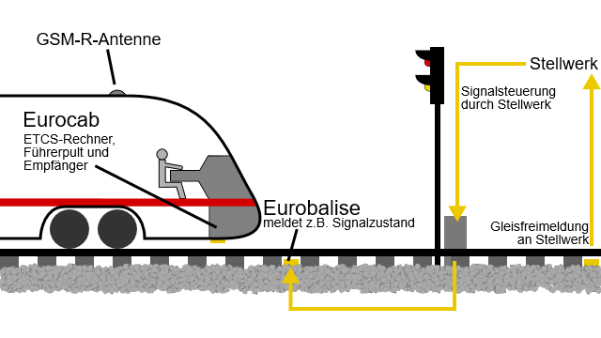
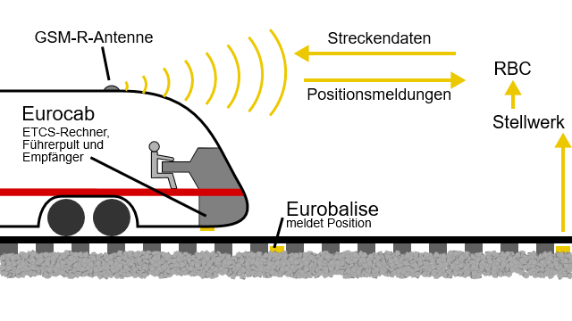
ETCS test and measurement system
ETCS L1
ETCS L2
Európai Vonatbefolyásoló Rendszer
(European Train Control System, ETCS)

Slide 12
The subsystems of the ETCS test equipment
Suitable for testing of the ETCS 1 and ETCS 2 track-side subsystem
ETCS onboard equipment does not intervene in the brake system and the traction control of the vehicle (SIL 0 level)
The vehicle for the functions to be executed must be equipped with the following real hardware elements:
Balise antenna,
Distance measurement units,
radar,
GSM-R antenna
GSM-R –- EVC interface,
Juridical Recording Unit
interfaces,
ETCS key module, etc.
On safety level not but it shall be identical functionally certified with a full-service ETCS onboard system

Slide 13
GSM-R measurement system
MÁV ZRT. Have the GSM-R measurement system!
The GSM-R measurement system and the associated odometry shall be installed into vehicle with support of the manufacturer. Before the installation of the necessary measurement racks, current supply, measurement places, the cabling between the rack and the measurement place shall be designed and the antennas and the antenna system shall be installed.

Slide 14
The evaluation of the results of the measurement systems
The measurement system shall be capable of evaluating automatically or semi-automatically
During the evaluation of the measurement results a fault list shall be prepared on the exceedance of the limit values
On demand it shall provide the printing possibility of the fault lists
A separate warning shall be sent on the traffic-dangerous places

Slide 15
Requirements Elvárások az indikatív árajánlatevőkkel szemben
Submission until the deadline
Indicative price
Feasibility closing date
Detailed technical description
Favourable cost-benefit ratio

Slide 16
Planned procedure
The documents of the indicative offer request are available, translation of the document executed until 20. October 2020.
Sending of the indicative price (5 possible Tenderers) sent until 22. October 2020. Consultation (on 12th of November 2020.)
Submission of the indicative price offers (27. November 2020.) (indicative price, feasibility timeframe, technical content)
Consultation on the tenders submitted on the week starting from the 7th of December
Assessment of the indicative offers (20. December 2020.), by this time the necessary budget and the feasibility timeframe will be known
Peparing and finalizing of a unified technical specification in February 2021.

